Slide 1

Analyzing the Influence of Weather, Unemployment, Mental Health, Race, Budget, and Staffing on Crime Rates
Big Data Tools and Technologies II
Group 4
•Himani •Kumud •Ali, Ahmed •Dabas, Rashika •Dimaculangan, Roan Kathrina •Ghelani, Kaushal •Ip, Chak Leung Vincent •Kapllani, Erinda •Muthusamy, Karthikeyan •Shukla, Bhumika Pravinkumar

Slide 2
Agenda
Overview of the Project
Objectives and Goals
Data Sources and Collection
Data Flow Diagram
Data Storage and Processing
PySpark ETL
PySpark Machine Learning
Data Visualization
Analysis and Findings

Slide 3
Introduction
The project embarks on a detailed investigation into how various environmental, socioeconomic, and institutional factors impact crime rates.
Utilizing a diverse array of datasets—encompassing weather patterns, unemployment rates, mental health incidents, racial demographics, law enforcement budgets, staffing levels, and comprehensive crime reports—it aims to unveil the complex relationship of external conditions and societal issues on community crime dynamics.
Notes:
Essential for law enforcement: Identifies patterns, trends, and hotspots of criminal activity.
Enables targeted crime prevention strategies: Helps allocate resources and deploy personnel effectively.
Empowers the community: Provides valuable information for personal safety and risk assessment.
Evaluates program effectiveness: Assesses the impact of existing crime prevention initiatives.
Informs evidence-based policies: Contributes to the development of policies enhancing overall public safety.
Fosters a secure environment: Aims to create a resilient urban setting for residents and visitors.

Slide 4
Objectives and Goals
Data Integration: Utilize Hadoop, MongoDB, MariaDB, Azure SQL, and Azure SQL Server Express for data ingestion and storage. Employ Snowflake, Alteryx, MS SQL Server Integration Services, and Azure Analysis Services for processing to create a unified, comprehensive database.
Predictive Modeling: Implement machine learning to forecast crime trends
Analytical Studies:
Weather vs. Crime: Analyze correlations between weather conditions and crime rates.
Economic Factors: Explore unemployment rates' influence on crime across regions.
Mental Health: Study the connection between mental health incidents and crime statistics.
Resource Allocation: Assess law enforcement budget efficiency in crime prevention.
Staffing and Efficiency: Examine the impact of law enforcement staffing on crime rates and response times.
Notes:
Essential for law enforcement: Identifies patterns, trends, and hotspots of criminal activity.
Enables targeted crime prevention strategies: Helps allocate resources and deploy personnel effectively.
Empowers the community: Provides valuable information for personal safety and risk assessment.
Evaluates program effectiveness: Assesses the impact of existing crime prevention initiatives.
Informs evidence-based policies: Contributes to the development of policies enhancing overall public safety.
Fosters a secure environment: Aims to create a resilient urban setting for residents and visitors.

Slide 5
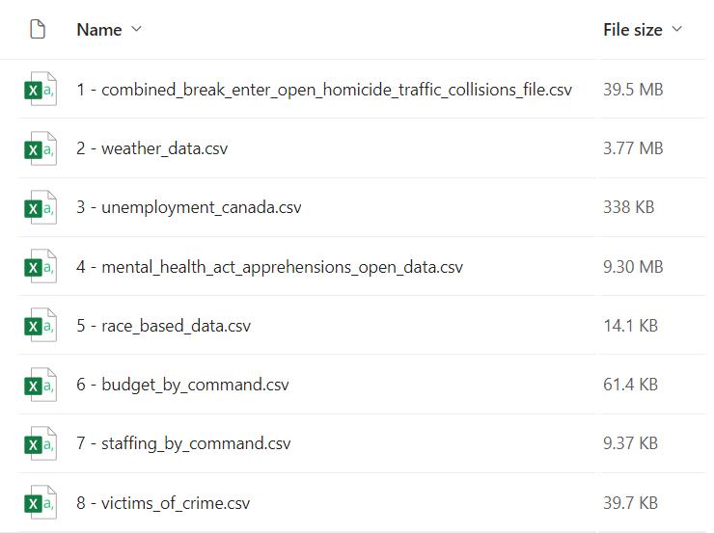
Data Sources and Collections
The project utilizes a variety of datasets, thoughtfully chosen to offer a thorough comprehension of the factors affecting crime rates. Here are the eight datasets picked by the team:

Slide 6
Data Sources and Collections
Dataset Name (Source URL) | Dataset Description | Attributes | Big Data Source (> 10,000 data points)
combined_break_enter_open_homicide_traffic_collisions_file.csv https://data.torontopolice.on.ca/datasets/040ead448df2412da252cfbb532e77ac_0/explore https://data.torontopolice.on.ca/datasets/d96bf5b67c1c49879f354dad51cf81f9_0/explore?location=43.722845%2C-79.374074%2C10.33 https://data.torontopolice.on.ca/datasets/bc4c72a793014a55a674984ef175a6f3_0/explore | A compilation of various crime incidents across Toronto, offering a detailed view of crime patterns and trends. | Object ID, Date Year, Day, Division, Homicide Type, Neighborhood, GPS (Lat, Long) | Yes (No. of data points: 281,347)
weather_data.csv https://www.kaggle.com/datasets/jasonzxho/toronto-city-centre-hourly-weather-data-20172020/code | Records of hourly weather conditions of Toronto since 2020-2023, essential for analyzing the impact of environmental factors on crime rates. This is. crucial for examining how environmental conditions might affect crime dynamics. | GPS (Lat, Long), Weather Station, Climate ID, Date, Time, Temp, Dew Point, Rel Humidity, Wind Dir, Wind Speed, Visibility, Air Pressure | Yes (No. of data points: 35,065)
mental_health_act_apprehensions_open_data.csv https://data.torontopolice.on.ca/datasets/333c4e1c96314741a83425045b6a7642_0/explore | Data on mental health-related law enforcement interventions since 2017, crucial for understanding the relationship between mental health issues and crime. | Object ID, Event Num, Date, Year, Month, Day, Hour, Division, Premises, Apprehend Type, Sex, Age Gp, Neighborhood | Yes (No. of data points: 43,279)

Slide 7
Data Sources and Collections
Dataset Name (Source URL) | Dataset Description | Attributes | Big Data Source (> 10,000 data points)
unemployment_canada.csv https://www.kaggle.com/datasets/pienik/unemployment-in-canada-by-province-1976-present | Statistics on unemployment rates across different regions, to examine economic influences on crime. | Province, Sex, Age Gp, Employment, FTE, Labour, PTE, Population, Unemployment rate, Employment rate | No
race_based_data.csv https://data.torontopolice.on.ca/datasets/TorontoPS::use-of-force-location-of-occurrences-rbdc-uof-tbl-003/explore | Information on the racial demographics of individuals involved in criminal incidents, to explore racial disparities in crime rates. | Type of incident, Location, Perceived Race, Incident ID, Object ID | No
budget_by_command.csv https://data.torontopolice.on.ca/datasets/TorontoPS::budget-by-command/explore | Financial data detailing law enforcement budgets, to assess the effect of resource allocation on crime prevention and resolution. | Year, Metric, Organization, Command, Category, Amount, Object ID | No
staffing_by_command.csv https://data.torontopolice.on.ca/datasets/2c5dcbc96e65479389d75f7e65001658_0/explore | Details on law enforcement staffing levels, to investigate the impact of manpower on crime rates and response times. | Year, Metric, Command, Category, Count, Object ID | No
victims_of_crime.csv https://data.torontopolice.on.ca/datasets/victims-of-crime-asr-vc-tbl-001/explore | Data on crime victims, providing insights into victimology and crime impact on different demographics. | Year, Category, Subtype, Assault, Sex, Age Gp, Count, Object ID | No

Slide 8
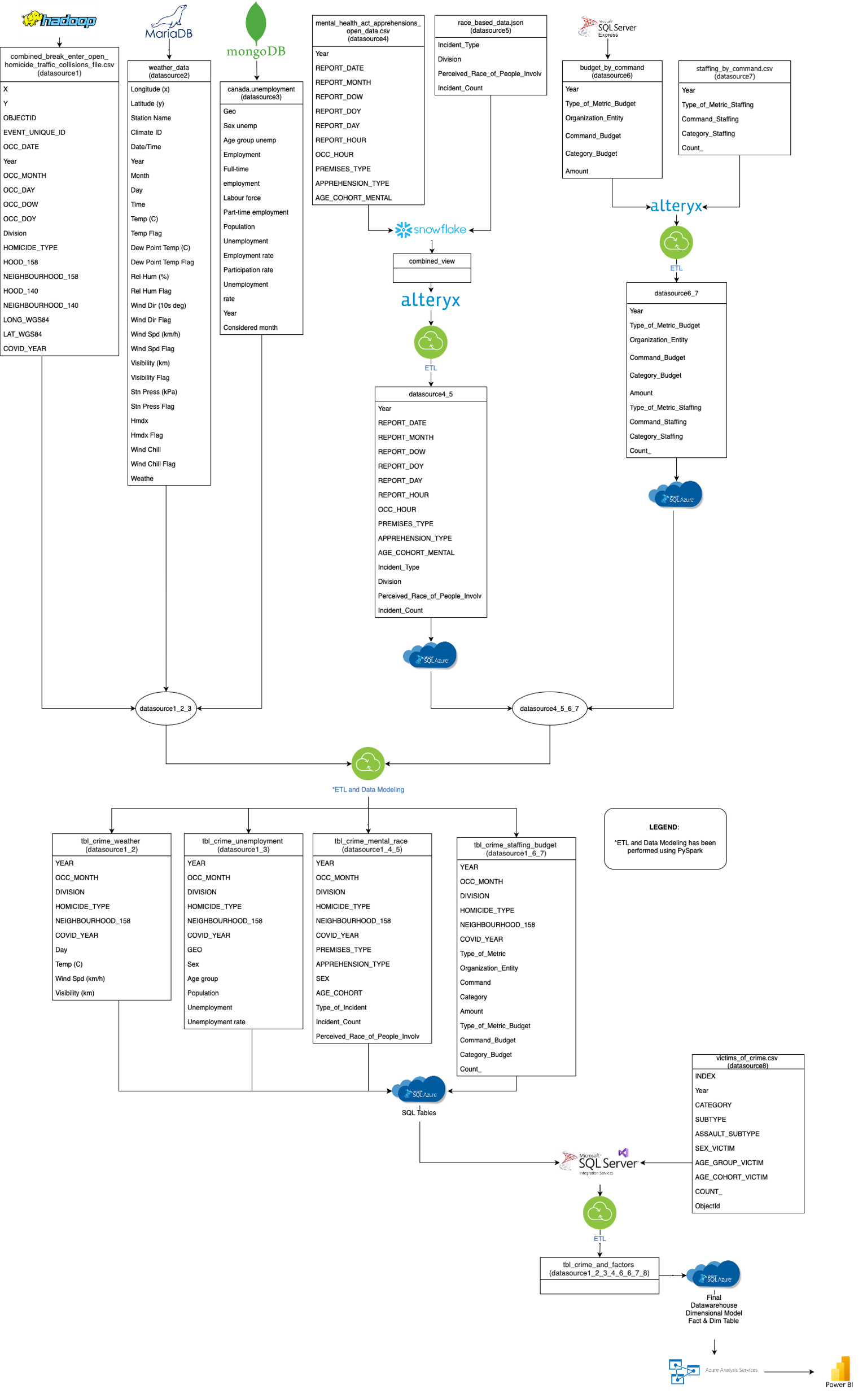
Data Flow Diagram

Slide 9
Data Flow Diagram (Contd.)
Data Ingestion and Storage:
Hadoop serves as a scalable and distributed repository for crime-related data storage.
MongoDB offers a flexible schema suitable for dynamic data such as unemployment rates.
MariaDB provides reliable SQL storage for structured weather data.
Azure SQL and Azure SQL Server Express act as cloud-based SQL databases for efficient data management and accessibility.
Data Processing Engines:
Snowflake provides a cloud-based data warehousing solution, coupled with Alteryx for data preparation and blending.
MS SQL Server Integration Services (SSIS) is employed for orchestrating ETL processes.
Azure Analysis Services delivers an enterprise-grade analytics engine

Slide 10
Data Flow Diagram (Contd.)
Analysis and Machine Learning:
PySpark is utilized for both ETL processes and the development of machine learning models. Two advanced deep learning models are constructed:
Model 1: LSTM for Crime Prediction Using Weather Data
Model 2: CNN for Crime Prediction Utilizing Race Data
Data Visualization and Reporting:
Crime Rate vs. Weather Conditions Analysis: Leveraging Datasource1, Datasource2, and Datasource8.
Economic Indicators and Crime Rates Analysis: Leveraging Datasource1, Datasource3, and Datasource8.
Mental Health and Crime Rates Analysis: Leveraging Datasource1, Datasource4, and Datasource8.
Race and Crime Rates Analysis: Leveraging Datasource1, Datasource5, and Datasource8.
Law Enforcement Resource Allocation Efficiency Analysis: Leveraging Datasource1, Datasource6, and Datasource8.
Staffing Impact on Law Enforcement Effectiveness Analysis: Leveraging Datasource1, Datasource7, and Datasource8

Slide 11
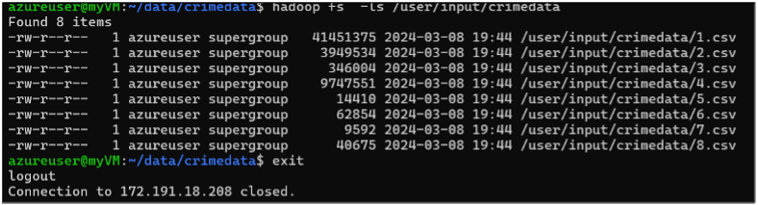
Data Storage and Processing
Hadoop (hdfs) Configuration
Datasource1: combined_break_enter_open_homicide_traffic_collisions_file.csv loaded into Hadoop HDFS

Slide 12
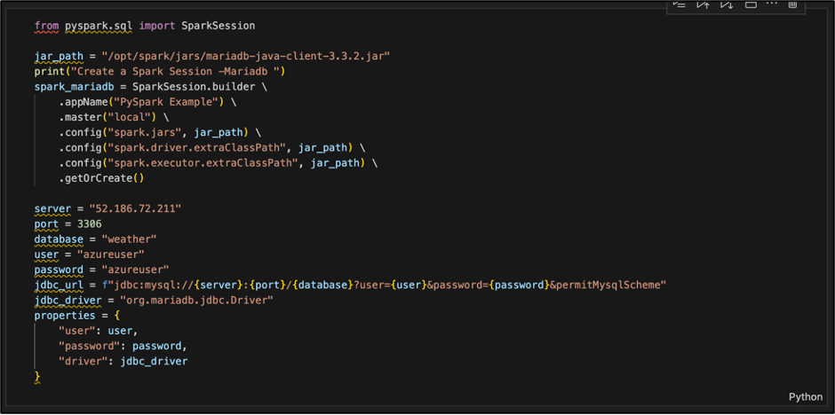
Data Storage and Processing
MariaDB Configuration

Slide 13
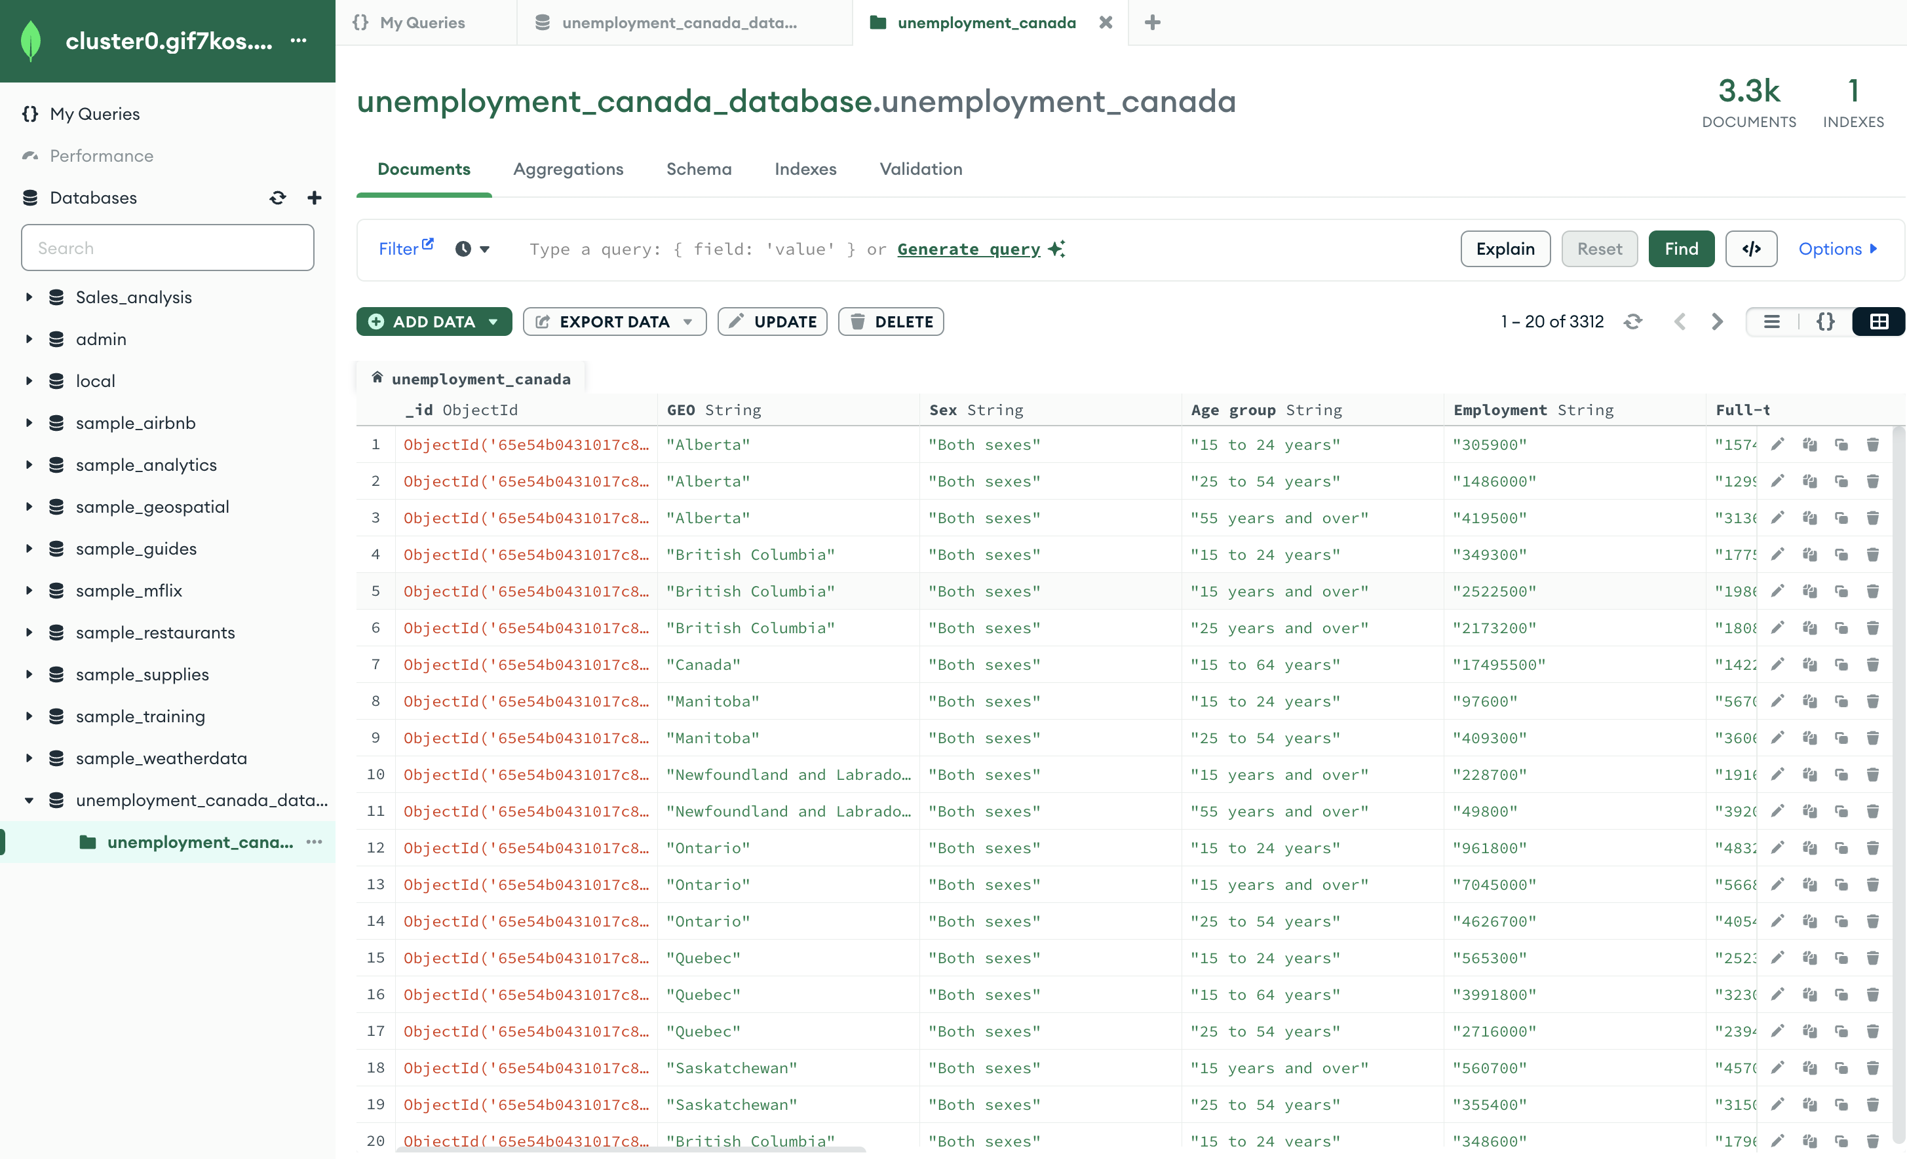
Data Storage and Processing
MongoDB Configuration
Datasource3:
unemployment_canada.csv data is integrated into MongoDB under below specified fields:
Cluster Name – Cluster0
Database Name – unemployment_canada_database
Collection Name – unemployment_canada

Slide 14
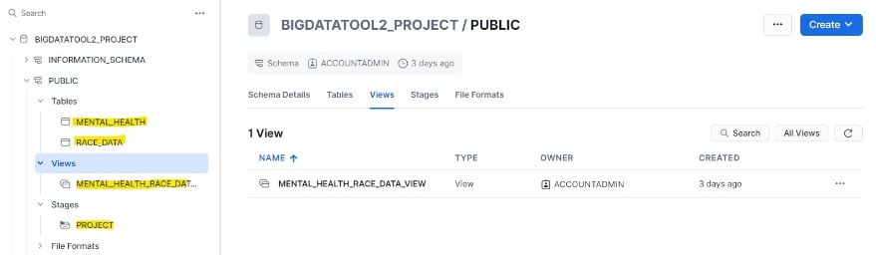
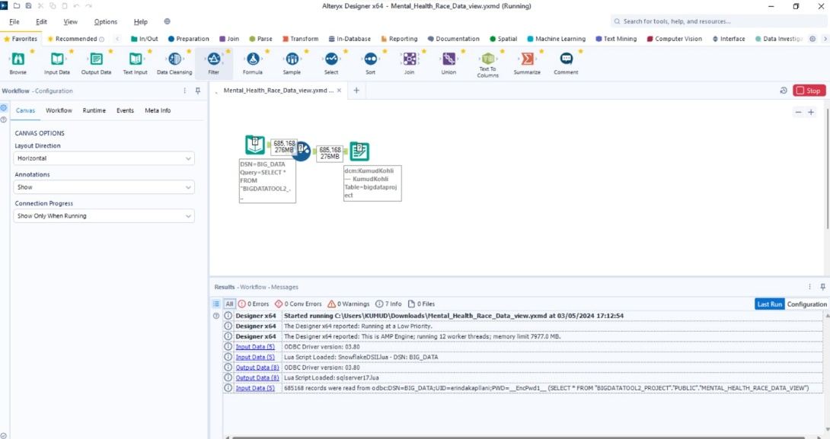
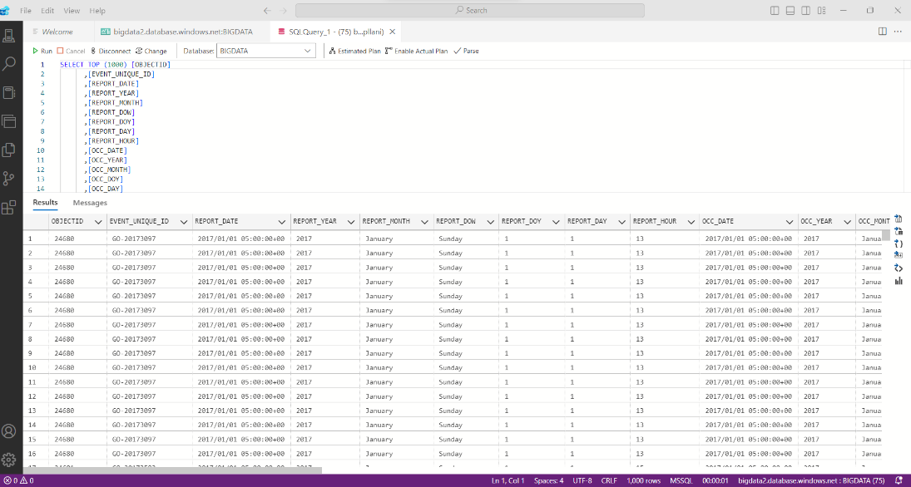
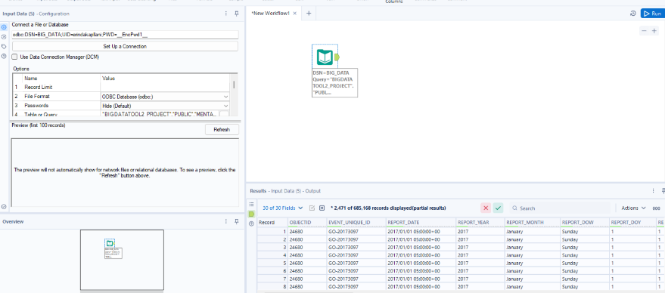
Data Storage and Processing
Snowflake-Alteryx-Azure SQL Configuration
Datasource4 & 5:
mental_health_act_apprehensions_open_data.csv and race_based_data.json are processed through the Snowflake-Alteryx-Azure SQL pipeline

Slide 15
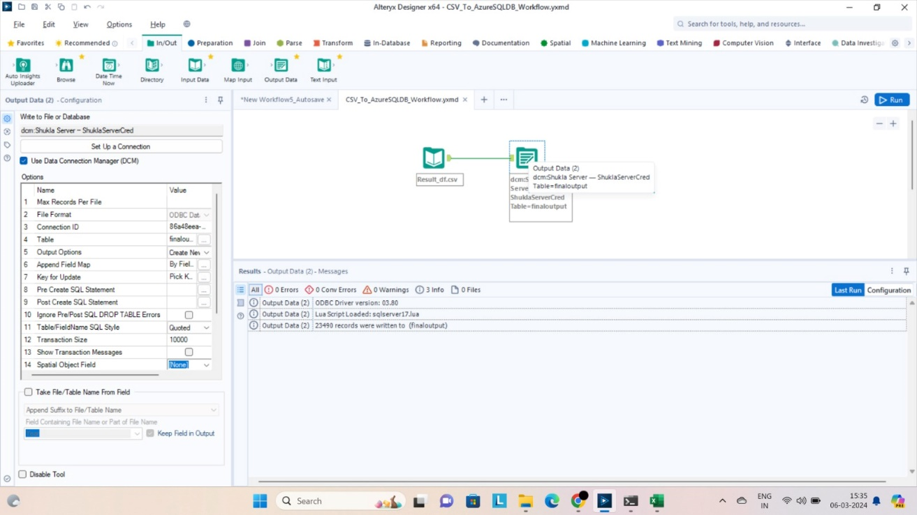
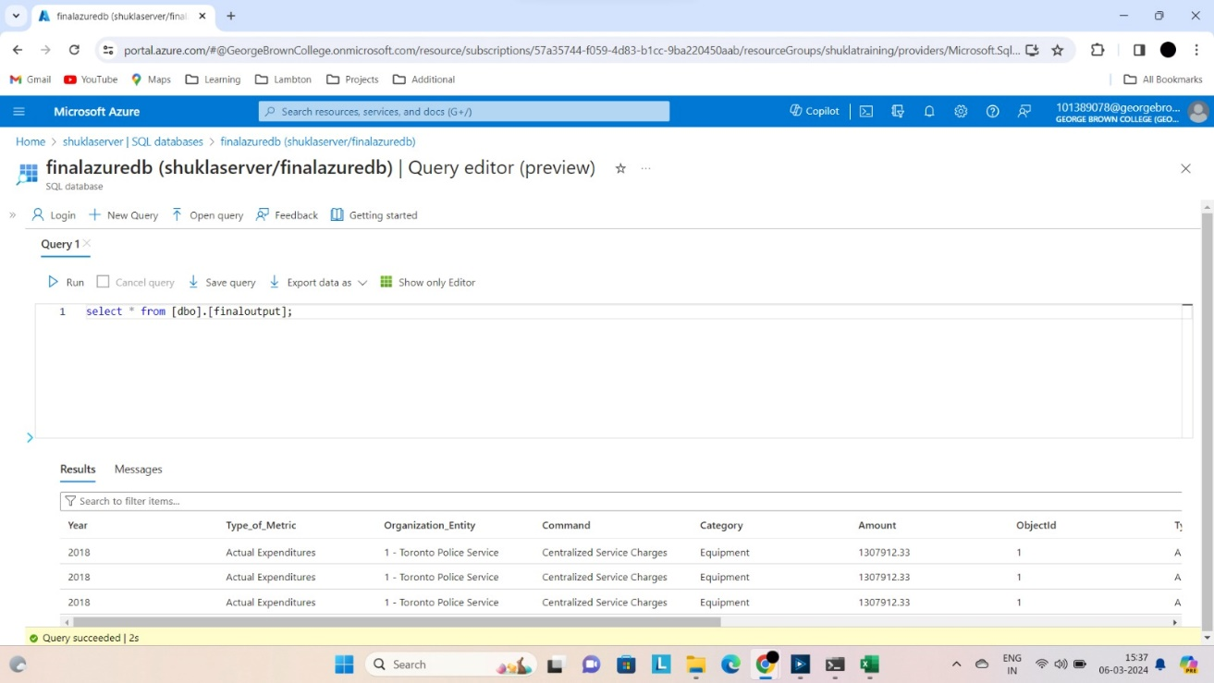
Data Storage and Processing
MS SQL Server-Alteryx-Azure SQL Configuration
Datasource6 & 7:
budget_by_command.csv and staffing_by_command.csv are channeled through the MS SQL Server Express-Alteryx-Azure SQL pipeline

Slide 16
Data Storage and Processing
MS SQL Server-Alteryx-Azure SQL Configuration
Datasource 8:
victims_of_crime.csv serves as additional data for various Reporting/ analyses was loaded in Virtual Machine.
DataSource8 - CSV

Slide 17
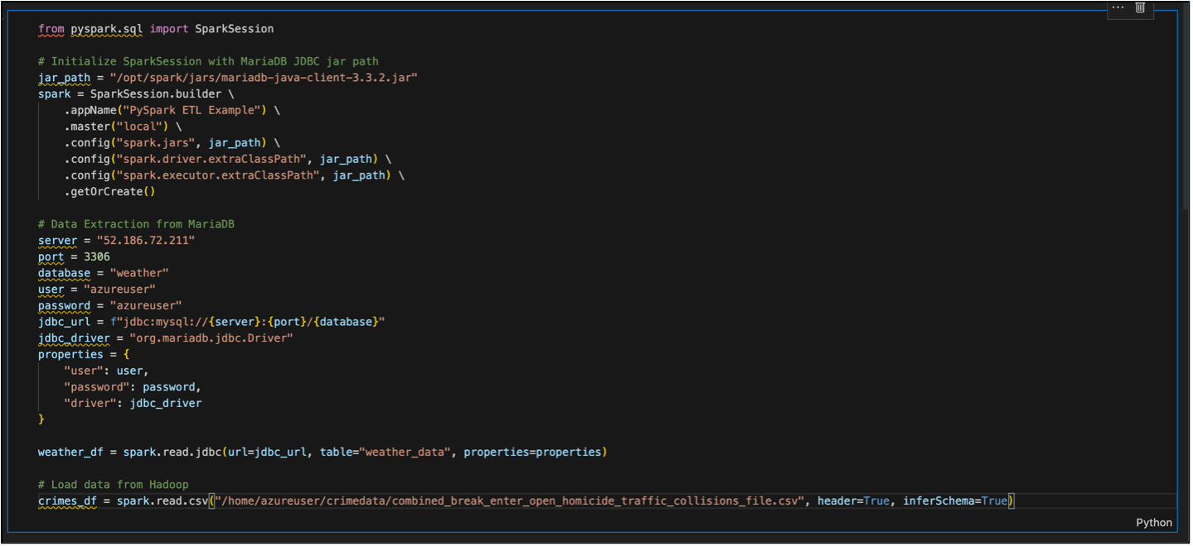
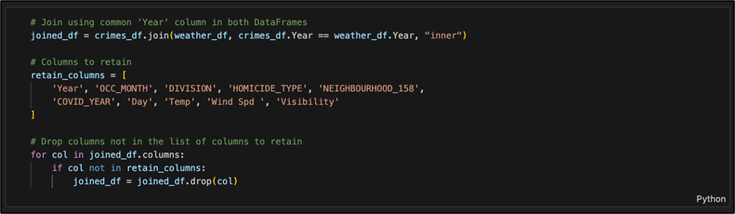
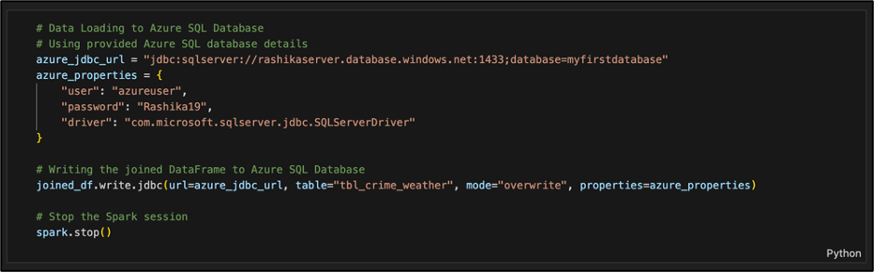
PySpark ETL
MariaDB Configuration and ETL stage
Crime Rate vs. Weather Conditions Analysis: Utilizing Crime Data (Datasource1) from Hadoop and Weather Data (DataSource2) from MariaDB, joining via ‘Year’ column, dropping unnecessary columns and saving the joined data to MS Azure SQL (tbl_crime_weather)

Slide 18
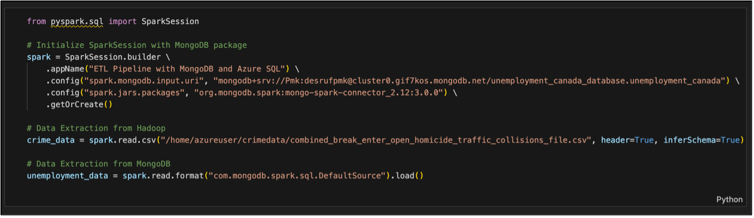
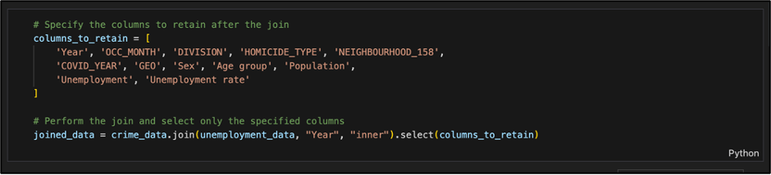
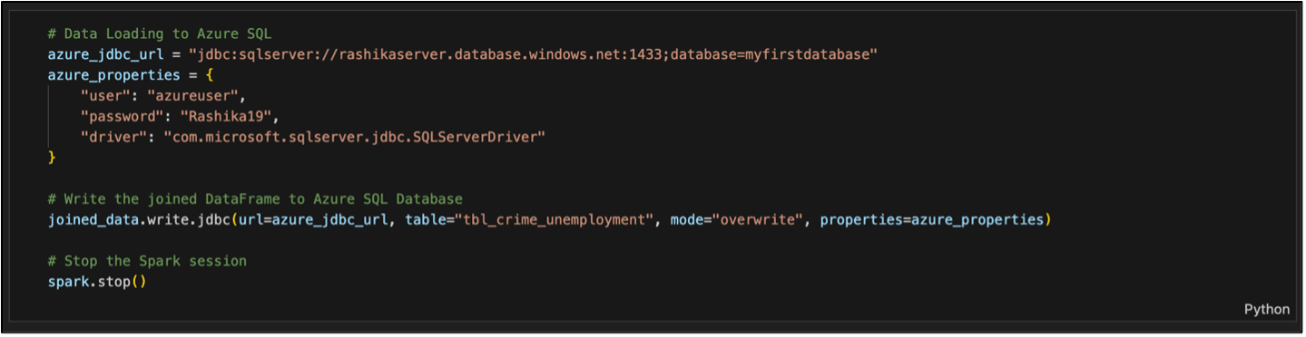
PySpark ETL
MongoDB Configuration and ETL stage
Economic Indicators and Crime Rates Analysis: Using crime data (Datasource1) from Hadoop and unemployment data (DataSource3) from MongoDB, merging them based on the 'Year' column, dropping unnecessary columns and storing the merged data in MS Azure SQL (tbl_crime_unemployment).

Slide 19
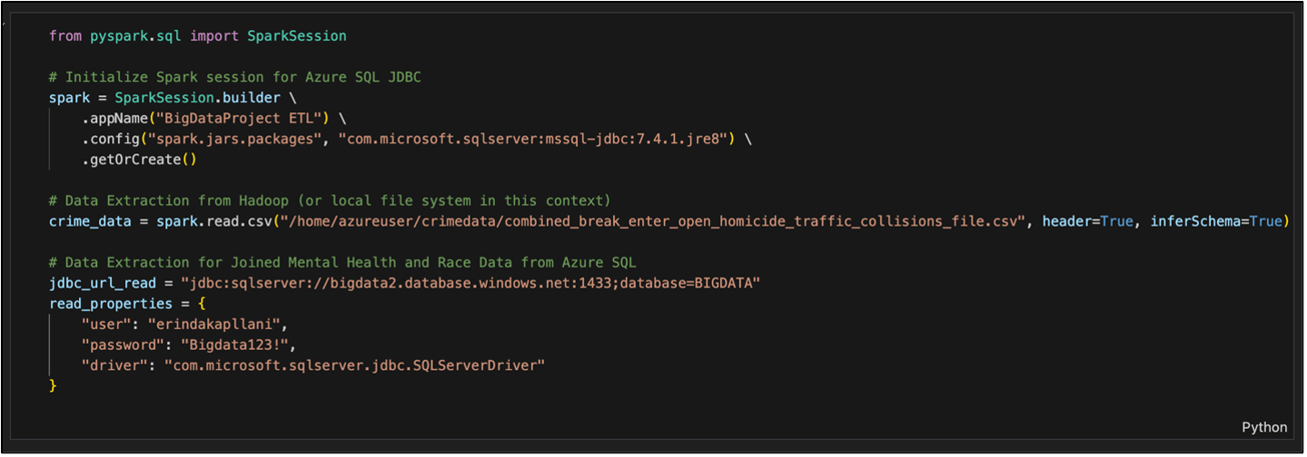
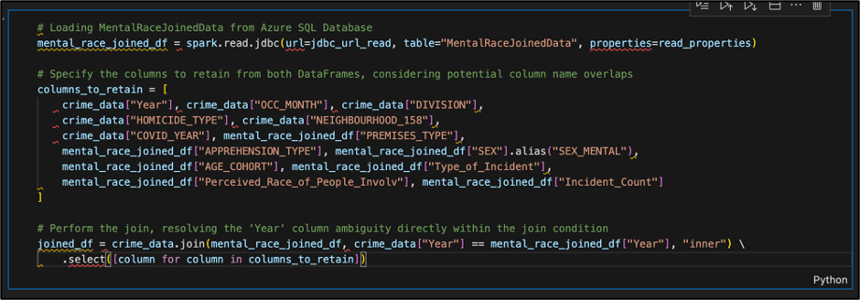
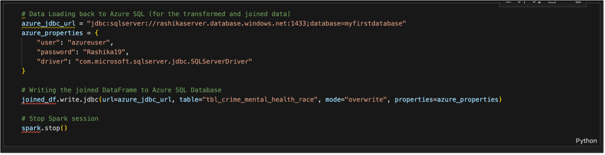
PySpark ETL
Resultant Datasets
Mental Health and Crime Rates Analysis and Race and Crime Rates Analysis: Leveraging Crime Data (Datasource1) sourced from Hadoop and Mental Health alongside Race Data (Datasource4 and 5) retrieved from MS Azure SQL, merging them based on the 'Year' column, dropping unnecessary columns and storing the combined dataset in MS Azure SQL (tbl_crime_mental_race).

Slide 20
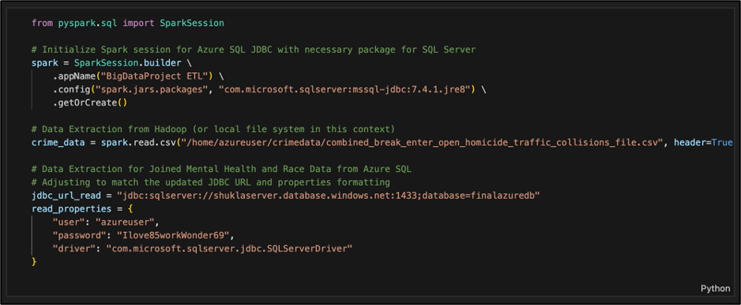
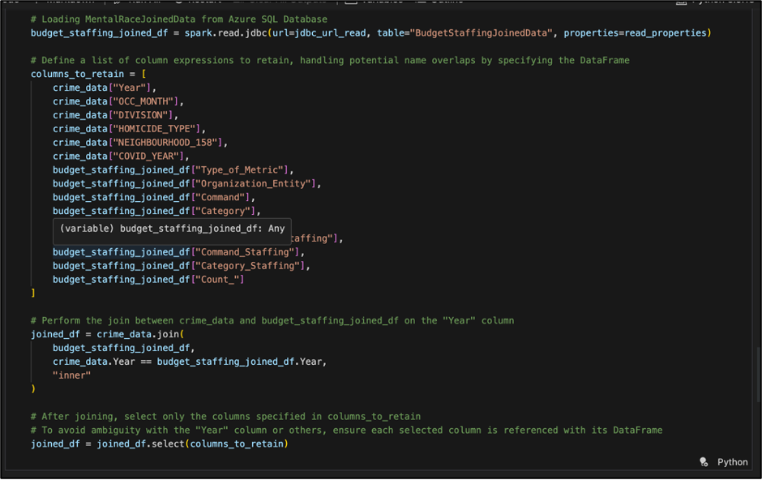
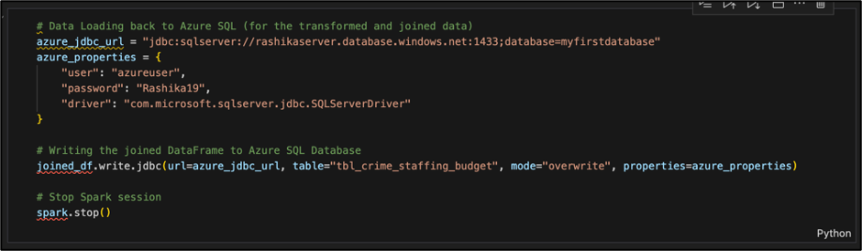
PySpark ETL
Resultant Datasets (Contd.)
Law Enforcement Resource Allocation Efficiency Analysis and
Staffing Impact on Law Enforcement Effectiveness Analysis: Using Crime Data (Datasource1) sourced from Hadoop and Staffing by Command alongside Budget by Command data (Datasource6 and 7) retrieved from MS Azure SQL, merging them based on the 'Year' column, dropping unnecessary columns and storing the combined dataset in MS Azure SQL (tbl_crime_staffing_budget).

Slide 21
PySpark Machine Learning Model 1: LSTM - For Crime Prediction Based on Weather Data
Model 1: LSTM for Crime Prediction Based on Weather Data
LSTM's superior ability to analyze and process time-series data effectively
LSTMs are designed to retain and utilize historical information over extended sequences
This predictive modeling strategy recognizes the intricate interplay between weather conditions and crime incidents, leveraging LSTM's strengths in handling sequences of varying lengths and addressing the vanishing gradient issue commonly encountered in standard Recurrent Neural Networks (RNNs).

Slide 22
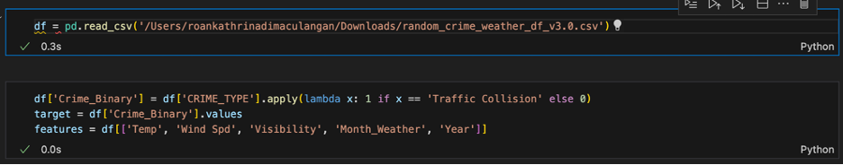
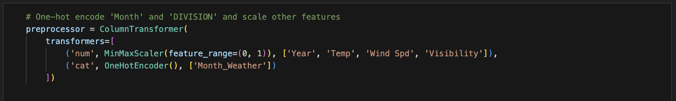
PySpark Machine Learning Model 1: LSTM - For Crime Prediction Based on Weather Data
Loading and Feature Engineering:
Preprocessing

Slide 23
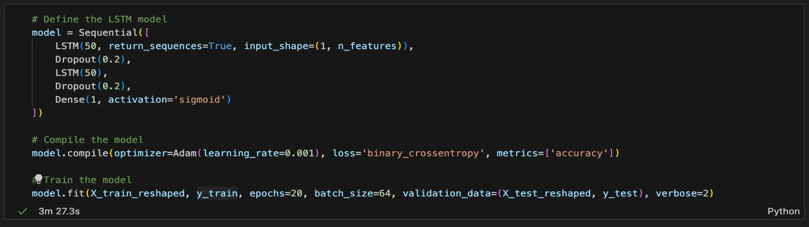
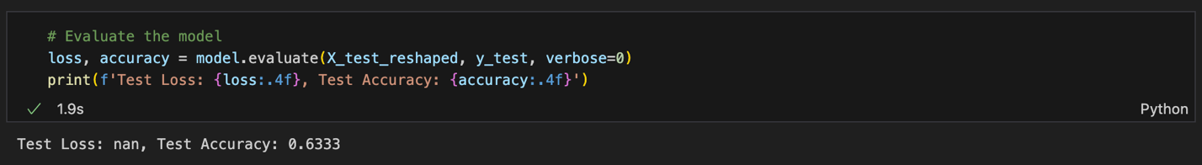
PySpark Machine Learning Model 1: LSTM - For Crime Prediction Based on Weather Data
Model Architecture
Evaluation & Insights

Slide 24
PySpark Machine Learning 2. CNN - For Crime Prediction Based on Race Data
Model 2: CNN for Crime Prediction Based on Weather Data
The innovative use of Convolutional Neural Networks (CNNs) for predicting crime based on race data relies on CNNs' exceptional ability to extract features and recognize patterns within structured data. While CNNs are typically associated with image processing tasks, their adaptability enables them to extract local and hierarchical features from one-dimensional sequential data. This model exploits CNN's strengths to analyze the intricate relationship between crime occurrences and demographic factors, aiming to uncover underlying patterns contributing to crime predictions.

Slide 25
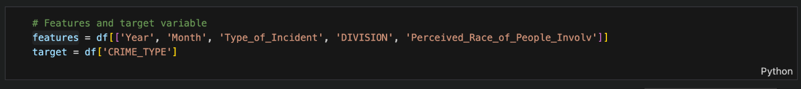
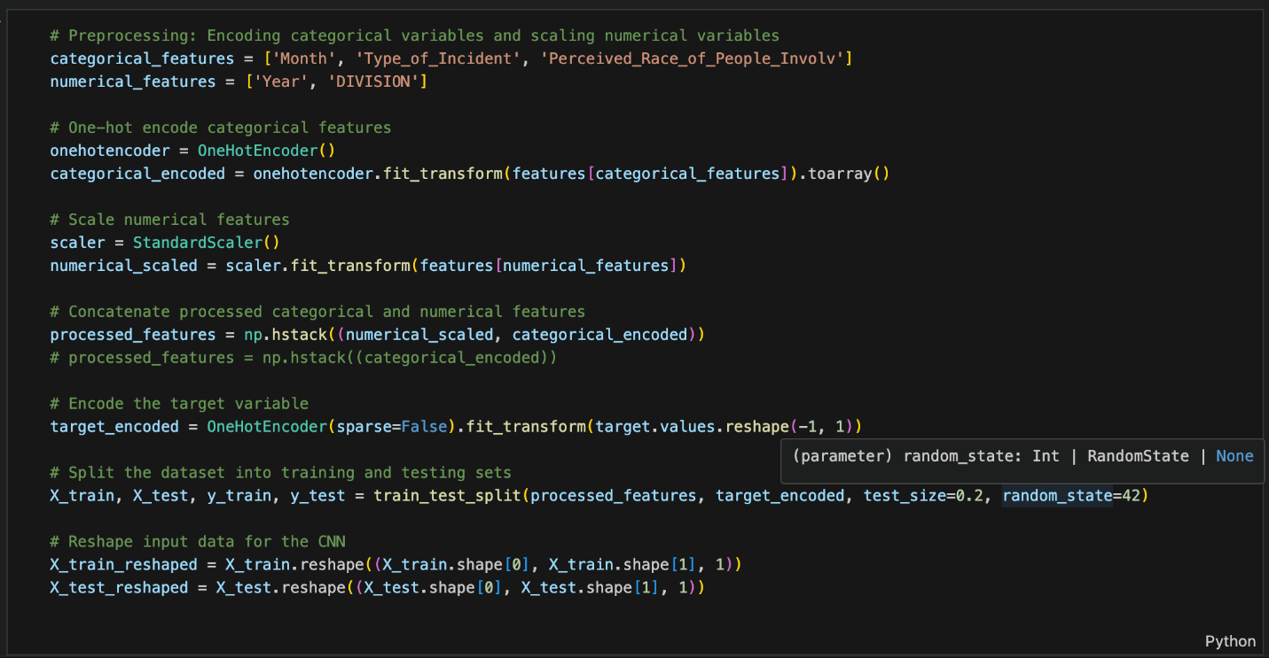
PySpark Machine Learning Model 2: CNN - For Crime Prediction Based on Race Data
Data Preparation and Model Implementation

Slide 26
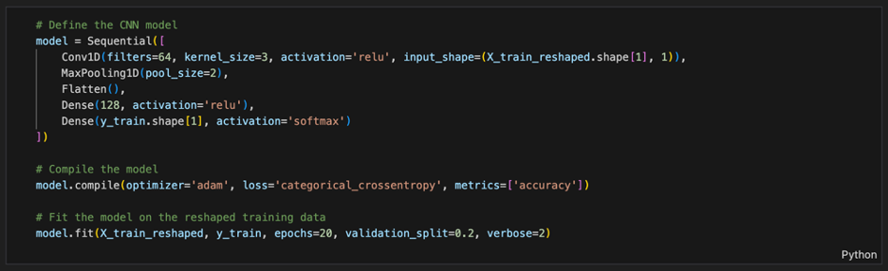
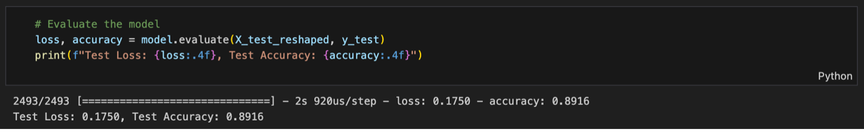
PySpark Machine Learning Model 2: CNN - For Crime Prediction Based on Race Data
Model Architecture
Evaluation & Insights

Slide 27
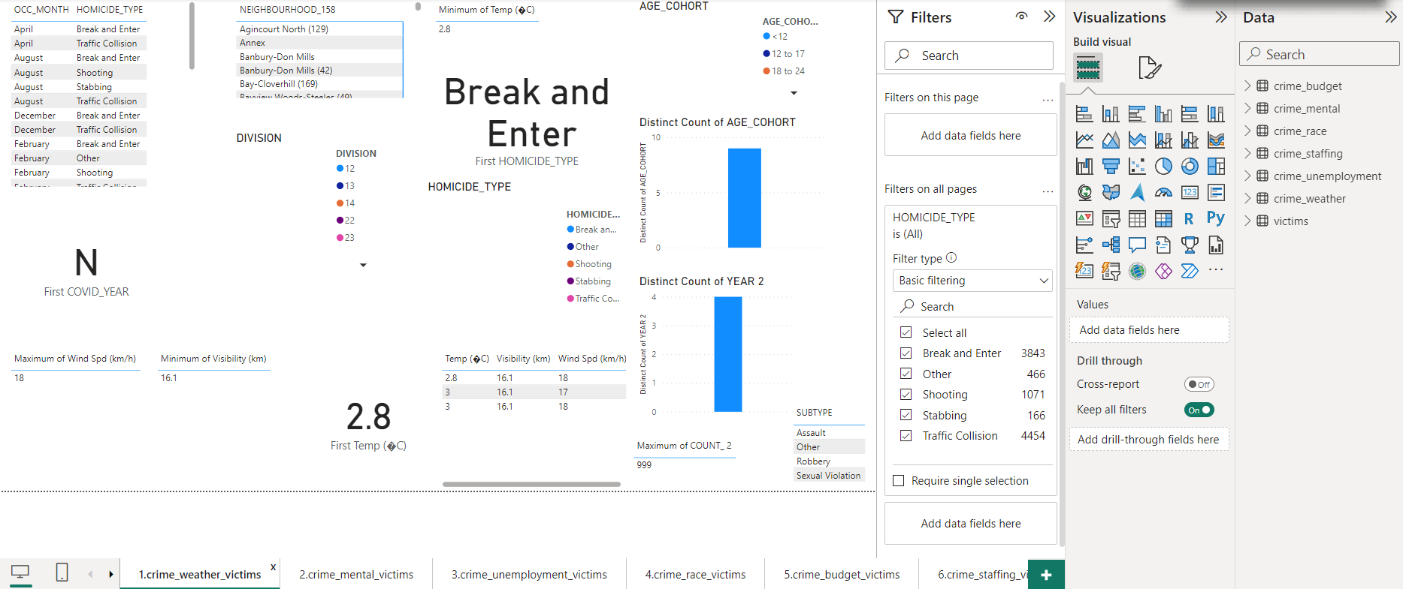
Data Visualization Reporting (via PowerBI): Crime Rates, Weather and Victims Data Analysis
Notes:
Crime Rates, Weather and Victims Data Analysis

Slide 28
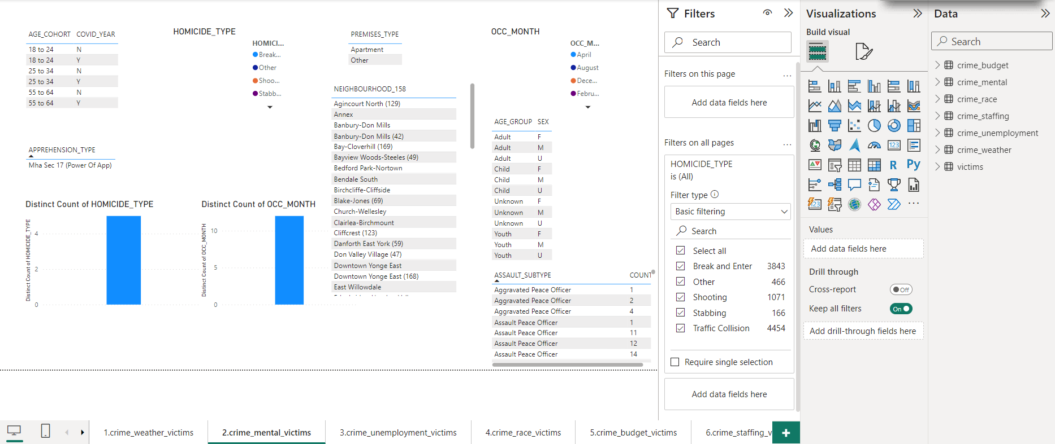
Data Visualization Reporting (via PowerBI): Crime Rates, Mental Health and Victims Data Analysis
Notes:
Crime Rates, Unemployment and Victims Data Analysis

Slide 29
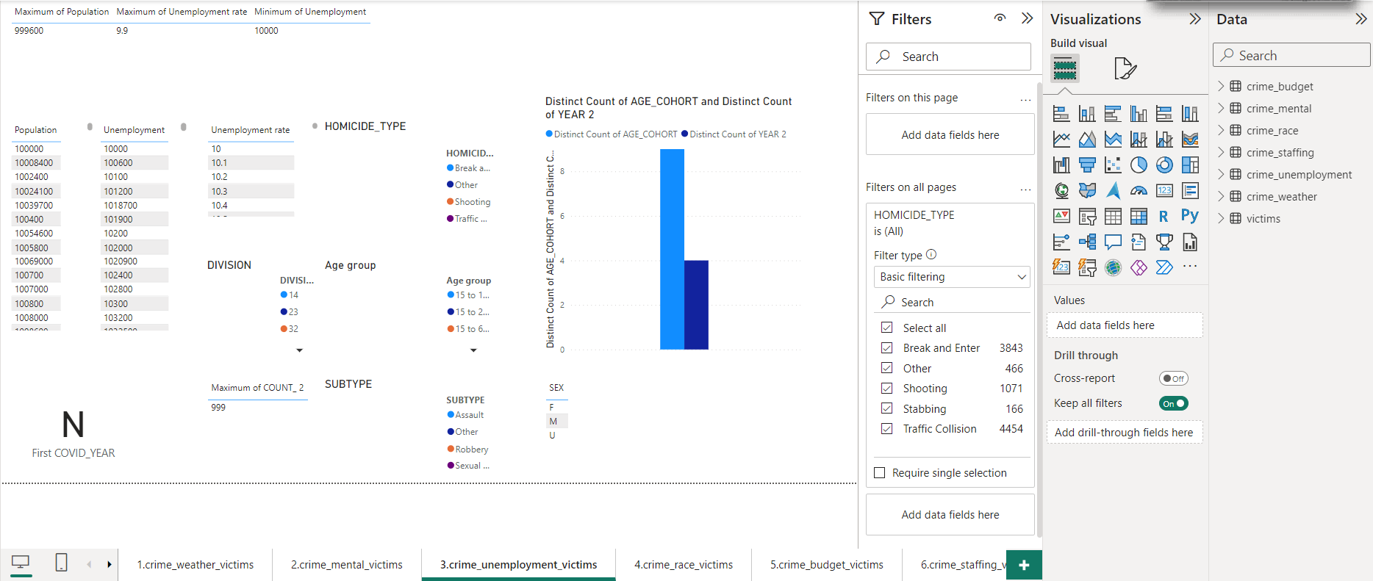
Data Visualization Reporting (via PowerBI): Crime Rates, Unemployment and Victims Data Analysis
Notes:
Crime Rates, Unemployment and Victims Data Analysis

Slide 30
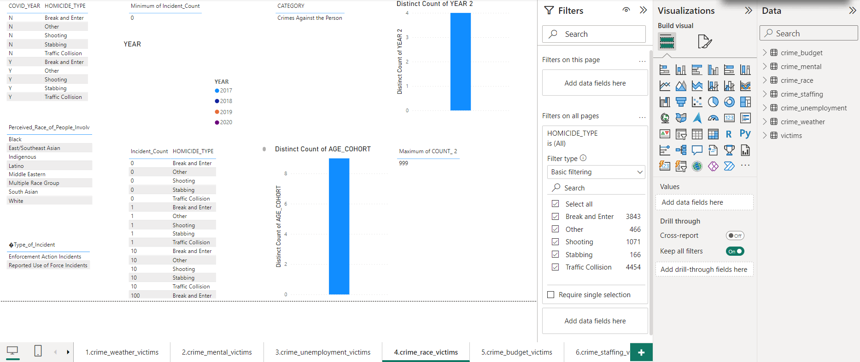
Data Visualization Reporting (via PowerBI): Crime Rates, Race and Victims Data Analysis
Notes:
Crime Rates, Unemployment and Victims Data Analysis

Slide 31
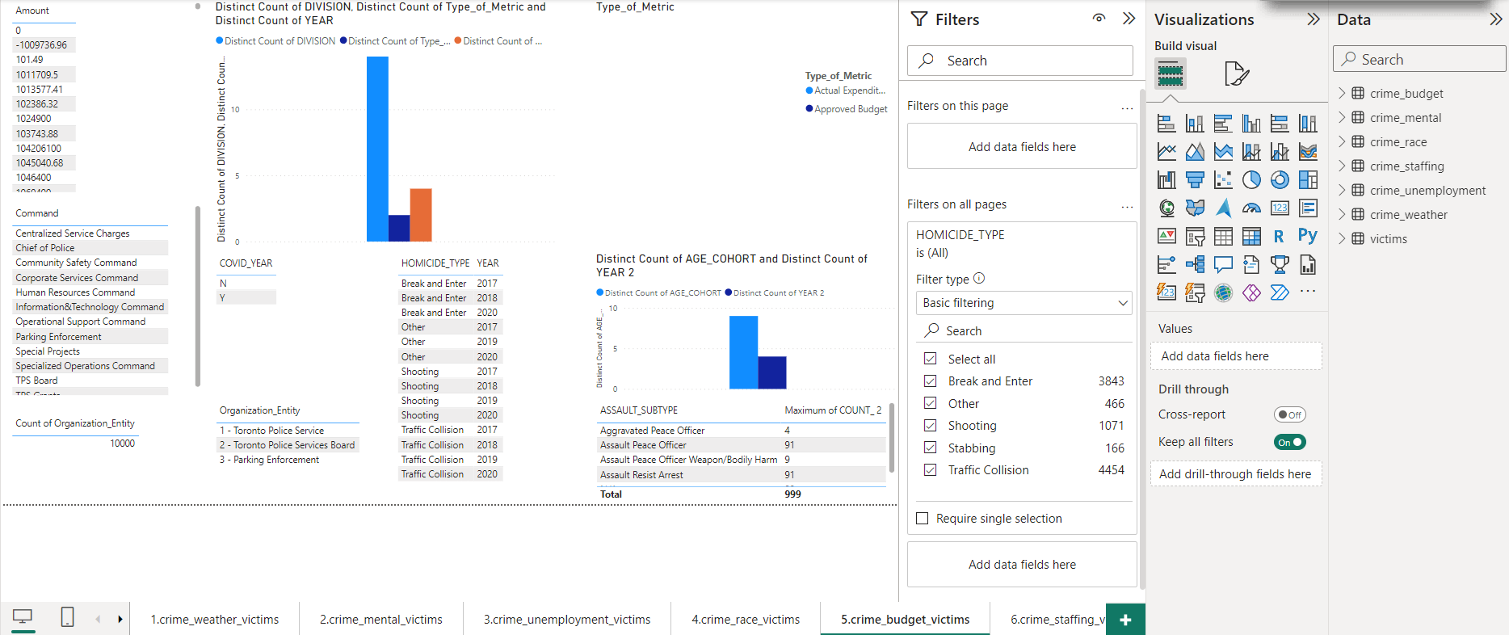
Data Visualization Reporting (via PowerBI): Crime Rates, Budget by Command and Victims Data Analysis
Notes:
Crime Rates, Unemployment and Victims Data Analysis

Slide 32
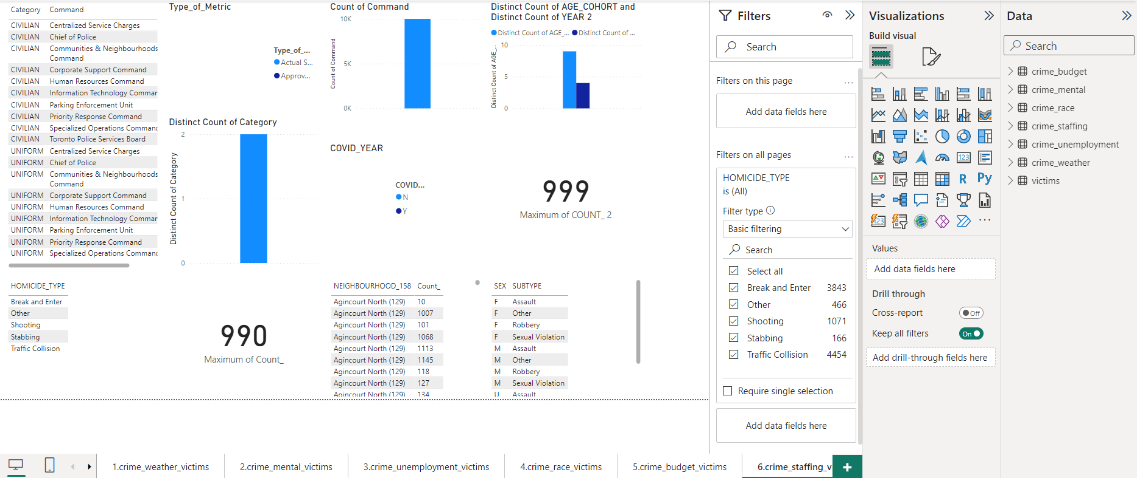
Data Visualization Reporting (via PowerBI): Crime Rates, Staffing by Command and Victims Data Analysis
Notes:
Crime Rates, Unemployment and Victims Data Analysis

